Slide 1
King’s County Sale Price Prediction
By: Jeffery Rosario

Slide 2
Problem Statement
Sale Price
Accurate linear regression models
House modifications
Notes:
We want to figure out the sale price of a house and how we can best profit from the sale of a house. We can do this by finding out the top predictors for the price of a house. If we find out the top predictors of the house, we can perform changes to the house at a price for a profit.

Slide 3
Business Value
Accurate Sale Price
Higher ROI
Clear Direction
Notes:
An accurate linear regression model will help determine the price of a property. This in turn will give us a higher return on investment.
Understanding which predictors are more important gives us a clear direction in how we proceed with modifying a house.

Slide 4
Methodology
2014-2015 house sales in King’s County, WA
21k rows of data
Multivariate Linear Regression
Categorical Variables - One-hot encoding
Continuous Variables - Log-transformations,
K-means clustering
Notes:
This dataset was derived from King’s County WA sale price of homes from 2014-2015.
A multivariate linear regression was performed on several variables. There was a combination of categorical and continuous variables. The categorical variables were one hot encoded. Th continuous variables had log transformations, a minmax scaler, and k-means clustering for longitude and latitude.

Slide 5
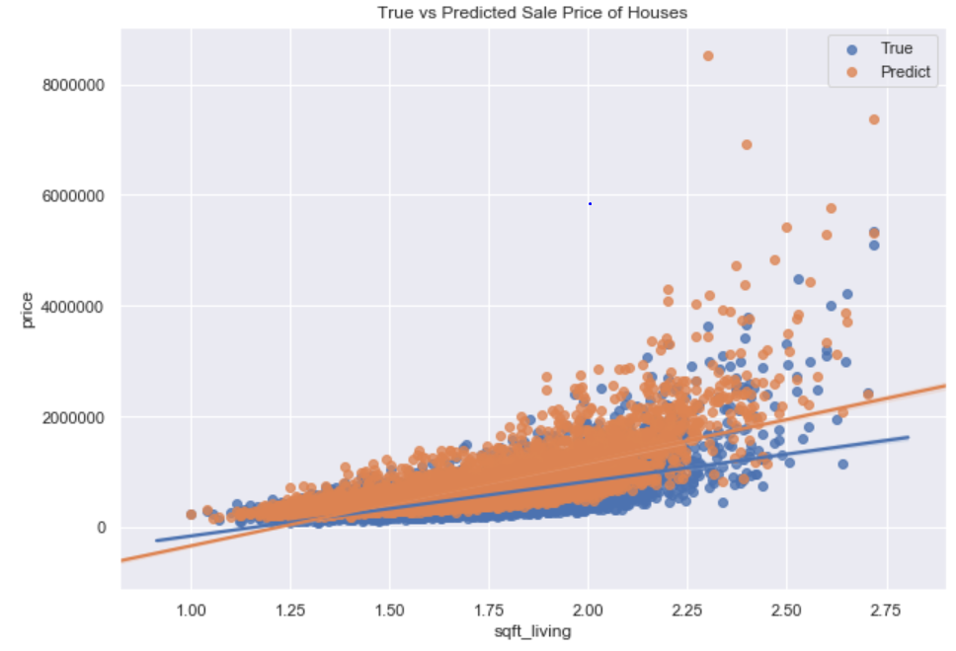
Predictions- Square footage of house
ACCURACY
Notes:
On this graph we have a depiction of the linear regression model using one predictor, the entire square footage of the property. The model highlights a high accuracy with the linear regression fit nearly on the same slope.

Slide 6
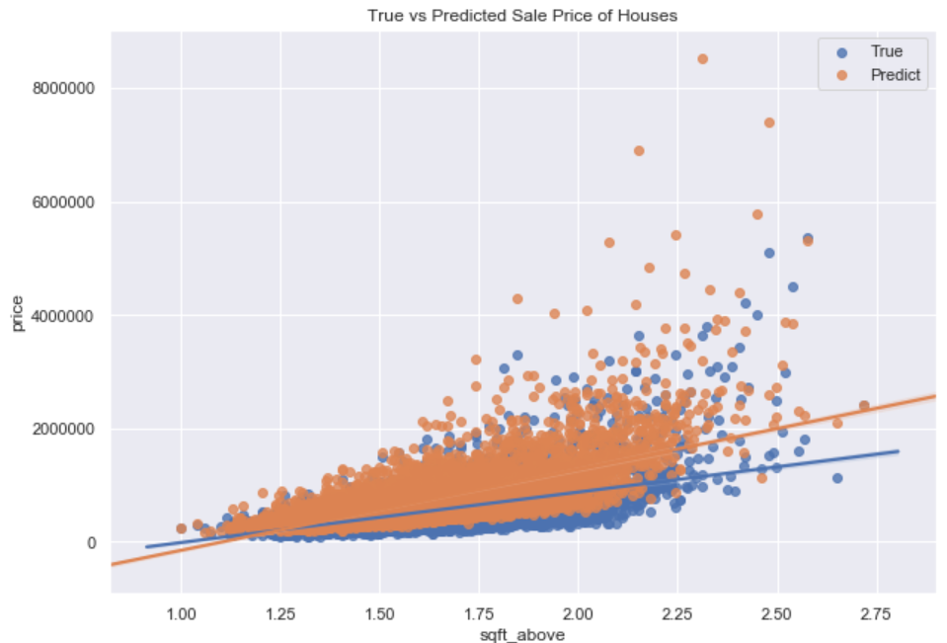
Predictions- Square footage above ground
ACCURACY
Notes:
One more predictor we can take a look at is the square footage above ground. The model shows a high accuracy showing the True and predicted values of the sale price at similar values.

Slide 7
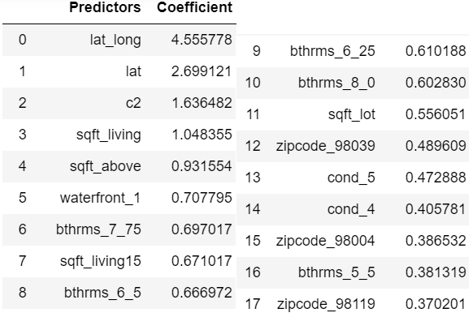
Findings
Square footage - above
Condition
Bathrooms
Notes:
These are the top predictors that have a positive influence on the sale price of the house.
The most important variables to determine the sale price of the house is the total square footage, square footage of the basement, above ground and the location. The square footage above the ground floor has the single highest coefficient which will allow house modifications.
The location of the property also ties into whether the house is more valuable or not. Using the latitude and longitude of the properties, 2 clusters were found to influence the sale price of a house. We can not change the location of the house, but keep in mind that fixing a house in different locations may lead to higher profit margins.
The condition of the property and the amount of bathrooms the property had influenced the price of the house.
The coefficients show an increasing value with respect to its categories. You see the bathrooms have a rising effect but there is a dropoff once you hit 8 bathrooms.

Slide 8
Recommendations
Square footage above ground
Bathrooms
Condition
Notes:
I recommend we buy property that only have a ground floor or has minimal square footage above ground. We can build a second or multiple floors to increase the square footage above ground. We can also increase the amount of bathrooms there are in the property. The property should also be in tip top condition. Houses in poor condition sold for less.

Slide 9
Future Work
Variance in sale price by location
Bigger dataset
Notes:
I’d like to take a look at the variance of the sale price by location. Maybe it might be better to focus on houses with lower sales price or higher sales price with higher margins. A bigger dataset will also be helpful.

Slide 10
THANK YOU

